Slide 1
Freeport East Innovation Strategy
March 2025

Slide 2

Contents
1.0
2.0
3.0
4.0
5.0
The Innovation opportunity at Freeport East
Our Innovation Strategy
Innovation assets available at Freeport East
Case studies – past and planned innovation initiatives
Get in touch
2

Slide 3


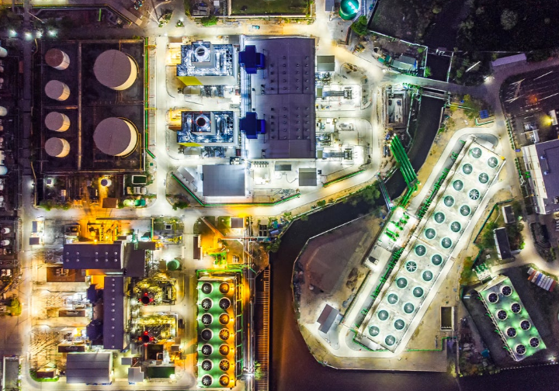
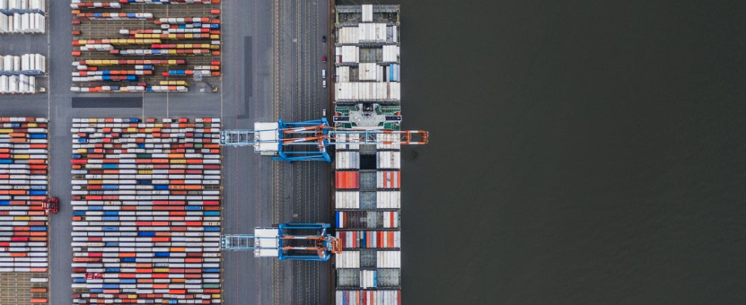
1.0
The Innovation Opportunity at Freeport East
Freeport East will act as a convener and catalyst to accelerate the development of innovative products and services by local businesses, leveraging its unique assets and existing innovation support.
Fund
Connect
We have funds to unlock innovation and commercialisation through our public and private partners – e.g. our Cyber Innovate to Elevate programme with Essex Uni
We are engaging and strengthening the ties across academia and industry partners including the Universities and Innovation hubs in the East of England
Attract
Deploy
Located next to 8 innovation clusters covering 4 sectors, 829 businesses and £3.2bn turnover, we will use this to attract investment into the region.
Centred around one of the UK’s most extensive port ecosystems, we will facilitate innovation to drive productivity and tackle social/economic disparities.
3

Slide 4
2.0
Our Innovation Strategy
A four-point strategy that responds to needs across the innovation journey
Our high-level theory of change:
IF Freeport East acts as an innovation catalyst to enhance and build on existing local innovation initiatives…
THEN local innovative businesses will be more successful in developing and selling innovative products and services….
BECAUSE they will have better access to strategic FUNDING, more CONNECTIONS with partners, increased likelihood of ATTRACTING investment, and more opportunities to DEPLOY their services/products in key markets.
FUND
Increase public and private sector innovation spending in the Freeport East area
CONNECT
Strengthen the places and connections that aid innovation thinking and activity
High-level innovation journey
Scale-up
Commerc-
ialisation
Diffusion & Implemen- tation
R&D
ATTRACT
Use innovation as an anchor for attracting new investment to Freeport East
DEPLOY
Facilitate the deployment of innovations to drive productivity and tackle social/economic disparities
4

Slide 5





2.1
FUND Increase public and private sector innovation spending in the Freeport East area
Outcomes
SMEs supported to secure
innovation funding by 2033
allocated by FPE to support local innovative businesses by 2033
business-academic partnerships supported to secure innovation funding by 2033
200
£10m
30
Activities
Work undertaken to date - examples
Allocate FPE’s funds to support businesses to innovate products or services
Provide advice/support to help industry and academic collaborations secure innovation funds for local business development
First round of programme funds totalling almost £1m have been completed and we have awarded grants of £985k+ to local businesses from our Innovation & Skills and Clean Growth Funds.
Leverage FPE’s access to Government innovation networks to secure funding for local businesses
Existing initiatives being leveraged - examples
5

Slide 6
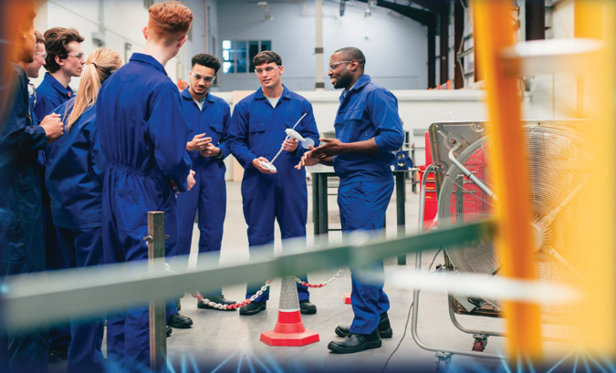




2.2
CONNECT Strengthen the physical and virtual places and connections that aid innovation thinking and activity, particularly in areas less well served currently
Outcomes
Innovation events by 2033 that bring together innovators, local businesses and academia.
Innovation centres established in the Freeport East Area.
Active place-based Innovation Clusters driving local innovation and identity.
25
3
3
Activities
Examples – work undertaken to date
Act as a node for the existing Connected Innovation Network (25 centres across Norfolk and Suffolk) to strengthen connections across business, academia and beyond.
Strengthen connections between innovation centres, to strengthen the local innovation offer to businesses.
Freeport East is active in the regional and national innovation landscape and has successfully brokered a range of new partnerships, including:
Shoreside Power from Optimised Hydrogen Lifecycle (SPOHL): - a £3m project;
PALLETS – a £1m project; 3) Hydrogen Zero Emmission Maritime (HyZEM) – a £1.44m project
Create innovation centres at Gateway 14 in Stowmarket, in Harwich and elsewhere, to establish new connections between local business, academia and wider innovation landscape.
Existing initiatives being leveraged
6

Slide 7








2.3
ATTRACT USE INNOVATION AS AN ANCHOR FOR ATTRACTING NEW INVESTMENT TO FREEPORT EAST
Outcomes
new investment attracted into Freeport East by 2033.
new businesses attracted into the region by 2033
£750m
30
Activities
Examples – work undertaken to date
Build a new dedicated Freeport East Innovation Cluster to attract/retain investment in key sectors
Freeport East –chaired bimonthly Inward Investment Group meeting with all local partners, to coordinate and liaise on FDI
Showcase opportunities in new sectors such as green hydrogen, digital and clean energy – including by undertaking strategic analysis
FPE’s first FDI, Rux Energy UK Ltd (first overseas subsidiary of an Australian company), focused on solutions for improved storage and distribution of hydrogen . First staff hired and office opened in Harwich.
FPE’s second FDI, Assan Panel, Türkiye (part of Kibar Holding) £45M investment. 100 new jobs to be created. Planning consent on Gateway 14
Support potential inward investors to connect to existing innovation networks
Provide first-rate aftercare for landed FDI
Existing initiatives being leveraged
7

Slide 8
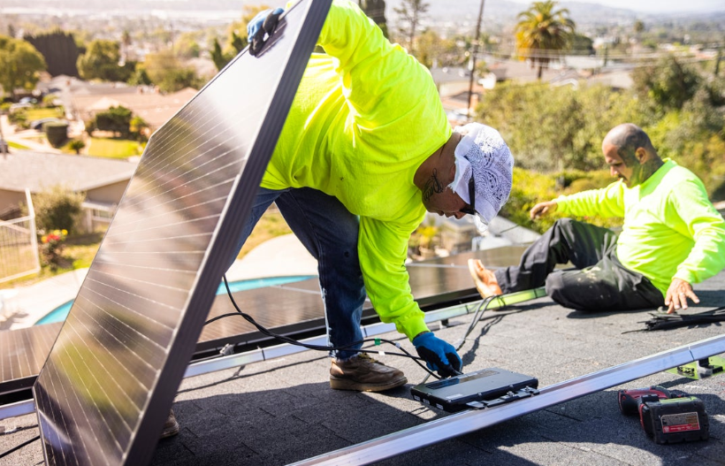





2.4
DEPLOY Work to facilitate the deployment of innovations across our region to drive productivity and tackle local social and economic disparities
Outcomes
50
Businesses supported to leverage new innovations to develop innovative new products or services
Innovation partnerships established that bring new technological innovations to local businesses and communities.
3
Activities
Examples – work undertaken to date
Identify opportunities for local businesses to deploy innovations in mobility, clean energy, healthcare, and education into local service delivery
Innovation & Skills and Clean Energy Funds - £c.1m awarded in the first round across 15 projects
Harwich Innovation Cluster SG supported
Gateway 14 Skills & Innovation Centre to be supported
Facilitate local businesses to secure commercial contracts for such deployments, working with UKRI, IUKBG, IUKBC, Catapults, DWP, both LSIPs, Schools, NHS Trusts, Health Innovation East), and other third sector organisations
Existing initiatives being leveraged
8

Slide 9
Test facilities/lab
3.0
Innovation Assets Accessible to FPE businesses
Office space
Advice & networks
Businesses locating in FPE can access a range of world-class innovation assets
Funding
Energy
Agri-Tech & -Food
AI / Digital
Adv. Manufacturing
X-Cutting
FPE Area
ORE Catapult, incl. Fit 4 Offshore Renewables
Agri-Tech East
Stowmarket Innovation Gateway
New Anglia Advanced Manufacturing & Engineering (NAAME)
University of Suffolk Innovation Labs
Essex Plant Innovation Centre
Adastral Park / Innovation Martlesham
Sudbury/Stowmarket Innovation Labs
Knowledge Gateway
Hetzel Engineering Centre
Digital Forum, Colchester
Tech East
Wider Geography
Orbis Energy CEFAS
MENTA
Broadland Food and Innovation Centre
Smart Emerging Technologies Institute (SETI) – UEA
Framlingham Technology Centre
East of England Energy Group (EEEGR)
Scottow Enterprise Park
Norwich Research Park
Akcela
East Wind
Anglia Capital Group
Hydrogen East
9

Slide 10
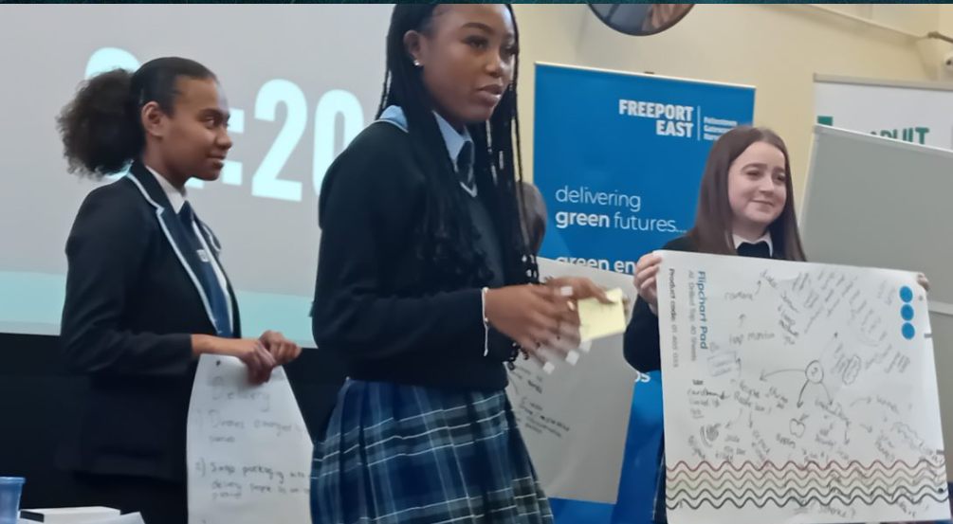
4.1
Case Study – Completed Innovation Activity
£1M Freeport East Clean Growth and Innovation & Skills Funds
Freeport East Clacton Event Inspires Young People about Opportunities in Freight & Logistics
The Clean Growth Fund provides financial assistance to local businesses focussed on clean energy and other priority industry sectors.
The Innovation and Skills Fund focuses on skills and innovation access in underserved communities.
In 2024, Freeport East with the Connected Places Catapult and Clacton Coastal Academy organised an industry workshop followed by a judged youth hackathon / pitching event in Clacton.
The event showcased a range of careers in the freight and logistics sector inspiring young people to consider exciting career opportunities.
The event was supported by the Department for Transport through the Freight Innovation Cluster operated by the Catapult.
Major employers also attended incl. Hutchison Ports UK, Colchester Institute, and DWP.
£1m has been awarded to offer support to small and growing businesses under both funds, fostering opportunities for new innovations and skills in high potential sectors (incl. green energy.)

Slide 11

4.2
Case Study – Planned Innovation Activity
Freeport East and Mid Suffolk District Council agree £18m funding package for Gateway 14 Skills & Innovation Centre
Harwich Innovation Cluster
£18.8m has been agreed to create a Skills & Innovation Centre at Gateway 14 in Stowmarket – the latest development there to support business, create jobs, and boost the local economy.
The Harwich Clean Energy & Maritime Innovation Cluster offers collaborative opportunities for local businesses, with recent developments on clean energy and with local industry partners incl. RWE, Firefly Fuels & HCS.
​
A recent report by sector specialists Opergy Group identified the potential steps to be taken to support the town’s progress to becoming a national leader in clean energy, including the potential for an eventual new iconic multi-million-pound innovation hub.
​
Freeport East has also set up the Harwich Innovation Hub with Shared Prosperity Fund Support from Tendring DC.
Mid Suffolk District Council’s plan for the three-storey centre at Gateway 14, part of the Freeport East site, includes:
office space for high growth start-ups,
collaboration spaces,
training and meeting rooms, and
a café.

Slide 12
5.0
Get In Touch
Check out our website for further information
www.freeporteast.com
Email us at:
enquiries@freeporteast.co.uk
12

